Slide 1
THiNK Ai
CHAT WITH YOUR NOTES AND IDEAS

Slide 2
ABOUT GROUP
PROJECT ID PG20CS25
PROJECT GUIDE
Dr Anver SR
TEAM MEMBERS:
HUBAIB P KSD20CS056
SHAHEER KSD20CS076
NANDANA KSD20CS077
JUNAID KSD20CS065

Slide 3
TABLE OF CONTENTS
01 INTRODUCTION 05 OBJECTIVES
02 PROBLEM STATEMENT 07 DESIGN & ARC
03 LITERATURE SURVEY 08 SAMPLE IMAGES
04 EXISTING WORK 09 CONCLUSION
10 REFERENCE

Slide 4
INTRODUCTION
Students and researchers often struggle to efficiently manage, analyze, and extract key insights from their notes and research materials. Existing solutions require users to manually provide context and structure to their notes, hindering the process and limiting productivity. This leads to wasted time, frustration, and ultimately impedes the research process

Slide 5
INTRODUCTION
So we are Introducing our latest project: a groundbreaking chatbot powered by Google Gemini Pro and LangChain. This innovative tool aims to streamline the management, analysis, and insight extraction from multiple PDF documents. Unlike existing solutions that rely on manual input for context and structure, our chatbot leverages advanced AI capabilities, including FAISS and Google Embedding. This enables swift access, analysis, and extraction of valuable insights from complex PDF files, enhancing efficiency and user experience in research endeavors.

Slide 6
PROBLEM STATEMENT

Slide 7
Develop a single unified platform that seamlessly integrates the functionalities of these four applications. This platform should allow users to upload or provide links to various data sources (PDFs, websites, YouTube videos, images) and engage in a single, comprehensive conversation with the AI, regardless of the data type.

Slide 8
FEATURES
Vector Databases: The PDF, website, and YouTube chatbots utilize vector databases to store and search through text data efficiently.
Chat Interface: Streamlit is used as the framework to create a user-friendly chat interface for interacting with the chatbots
RAG (Retrieval Augmented Generation) as a crucial technique in the website and YouTube chatbot programs

Slide 9
LLM (LARGE LANGUAGE MODEL)
A large language model (LLM) is a type of artificial intelligence (AI) program that They can generate text, translate languages, write different kinds of creative content, and answer your questions in an informative way. LLMs are trained on huge sets of data hence the name "large“.
DRAWBACKS OF LLM
Lack of source
Not up to date
Hallucination

Slide 10
RAG (Retrieval Augmented Generation)
Retrieval-augmented generation (RAG) is a technique for enhancing the accuracy and reliability of generative AI models with facts fetched from external sources.
Indexing
Retrieval
Generation
Benefits of RAG
Increased Accuracy
Up-to-date Information
Answer based on source

Slide 11
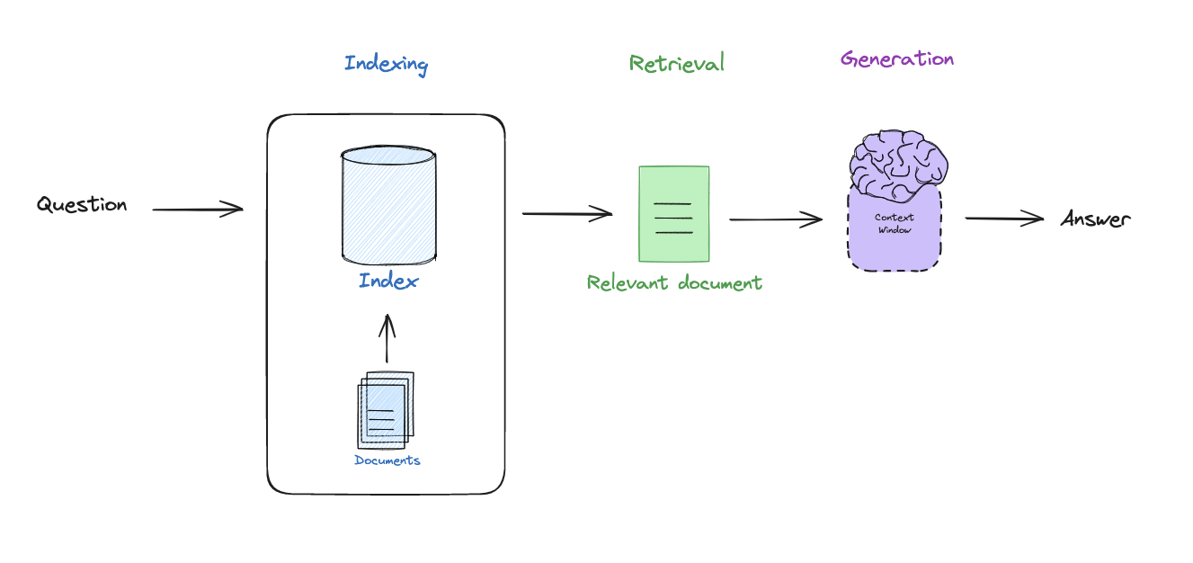
RAG (Retrieval Augmented Generation)

Slide 12
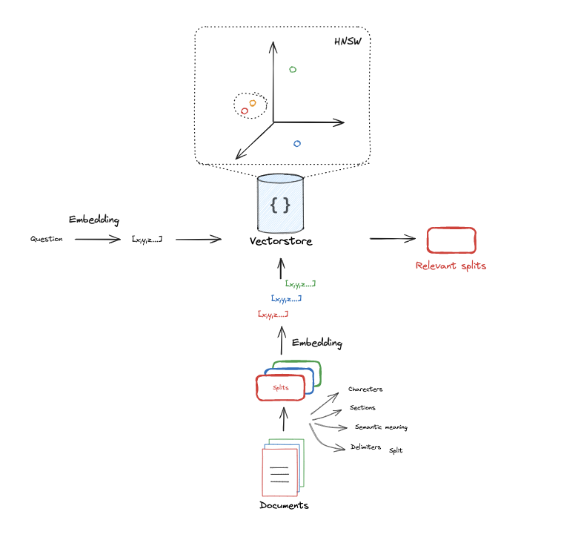
RAG (Retrieval Augmented Generation)

Slide 13
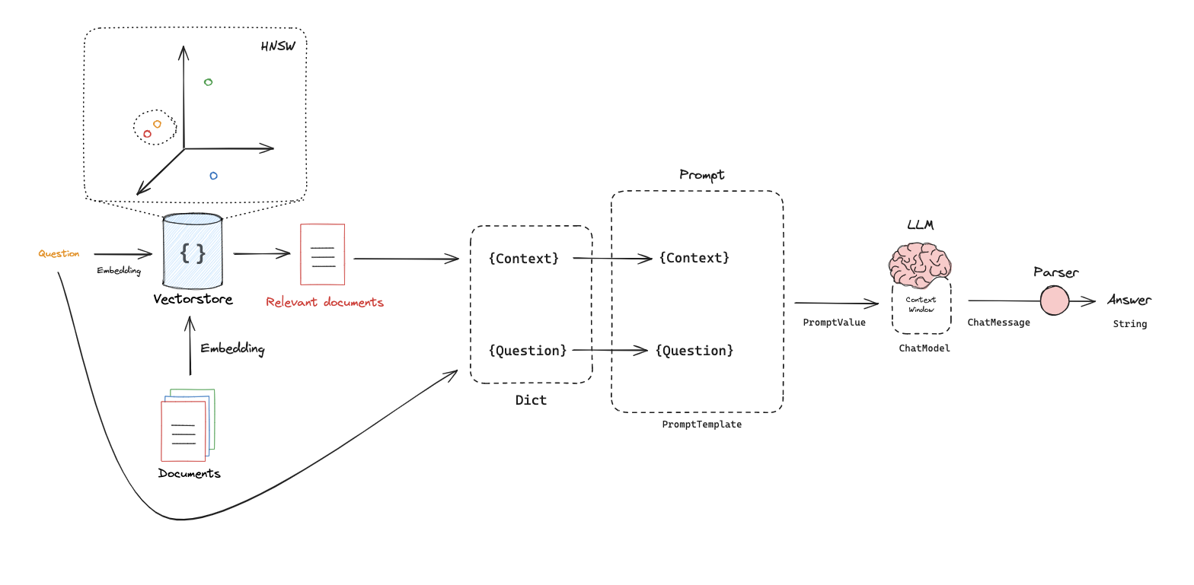
RAG (Retrieval Augmented Generation)

Slide 14
LITERATURE SURVEY

Slide 15
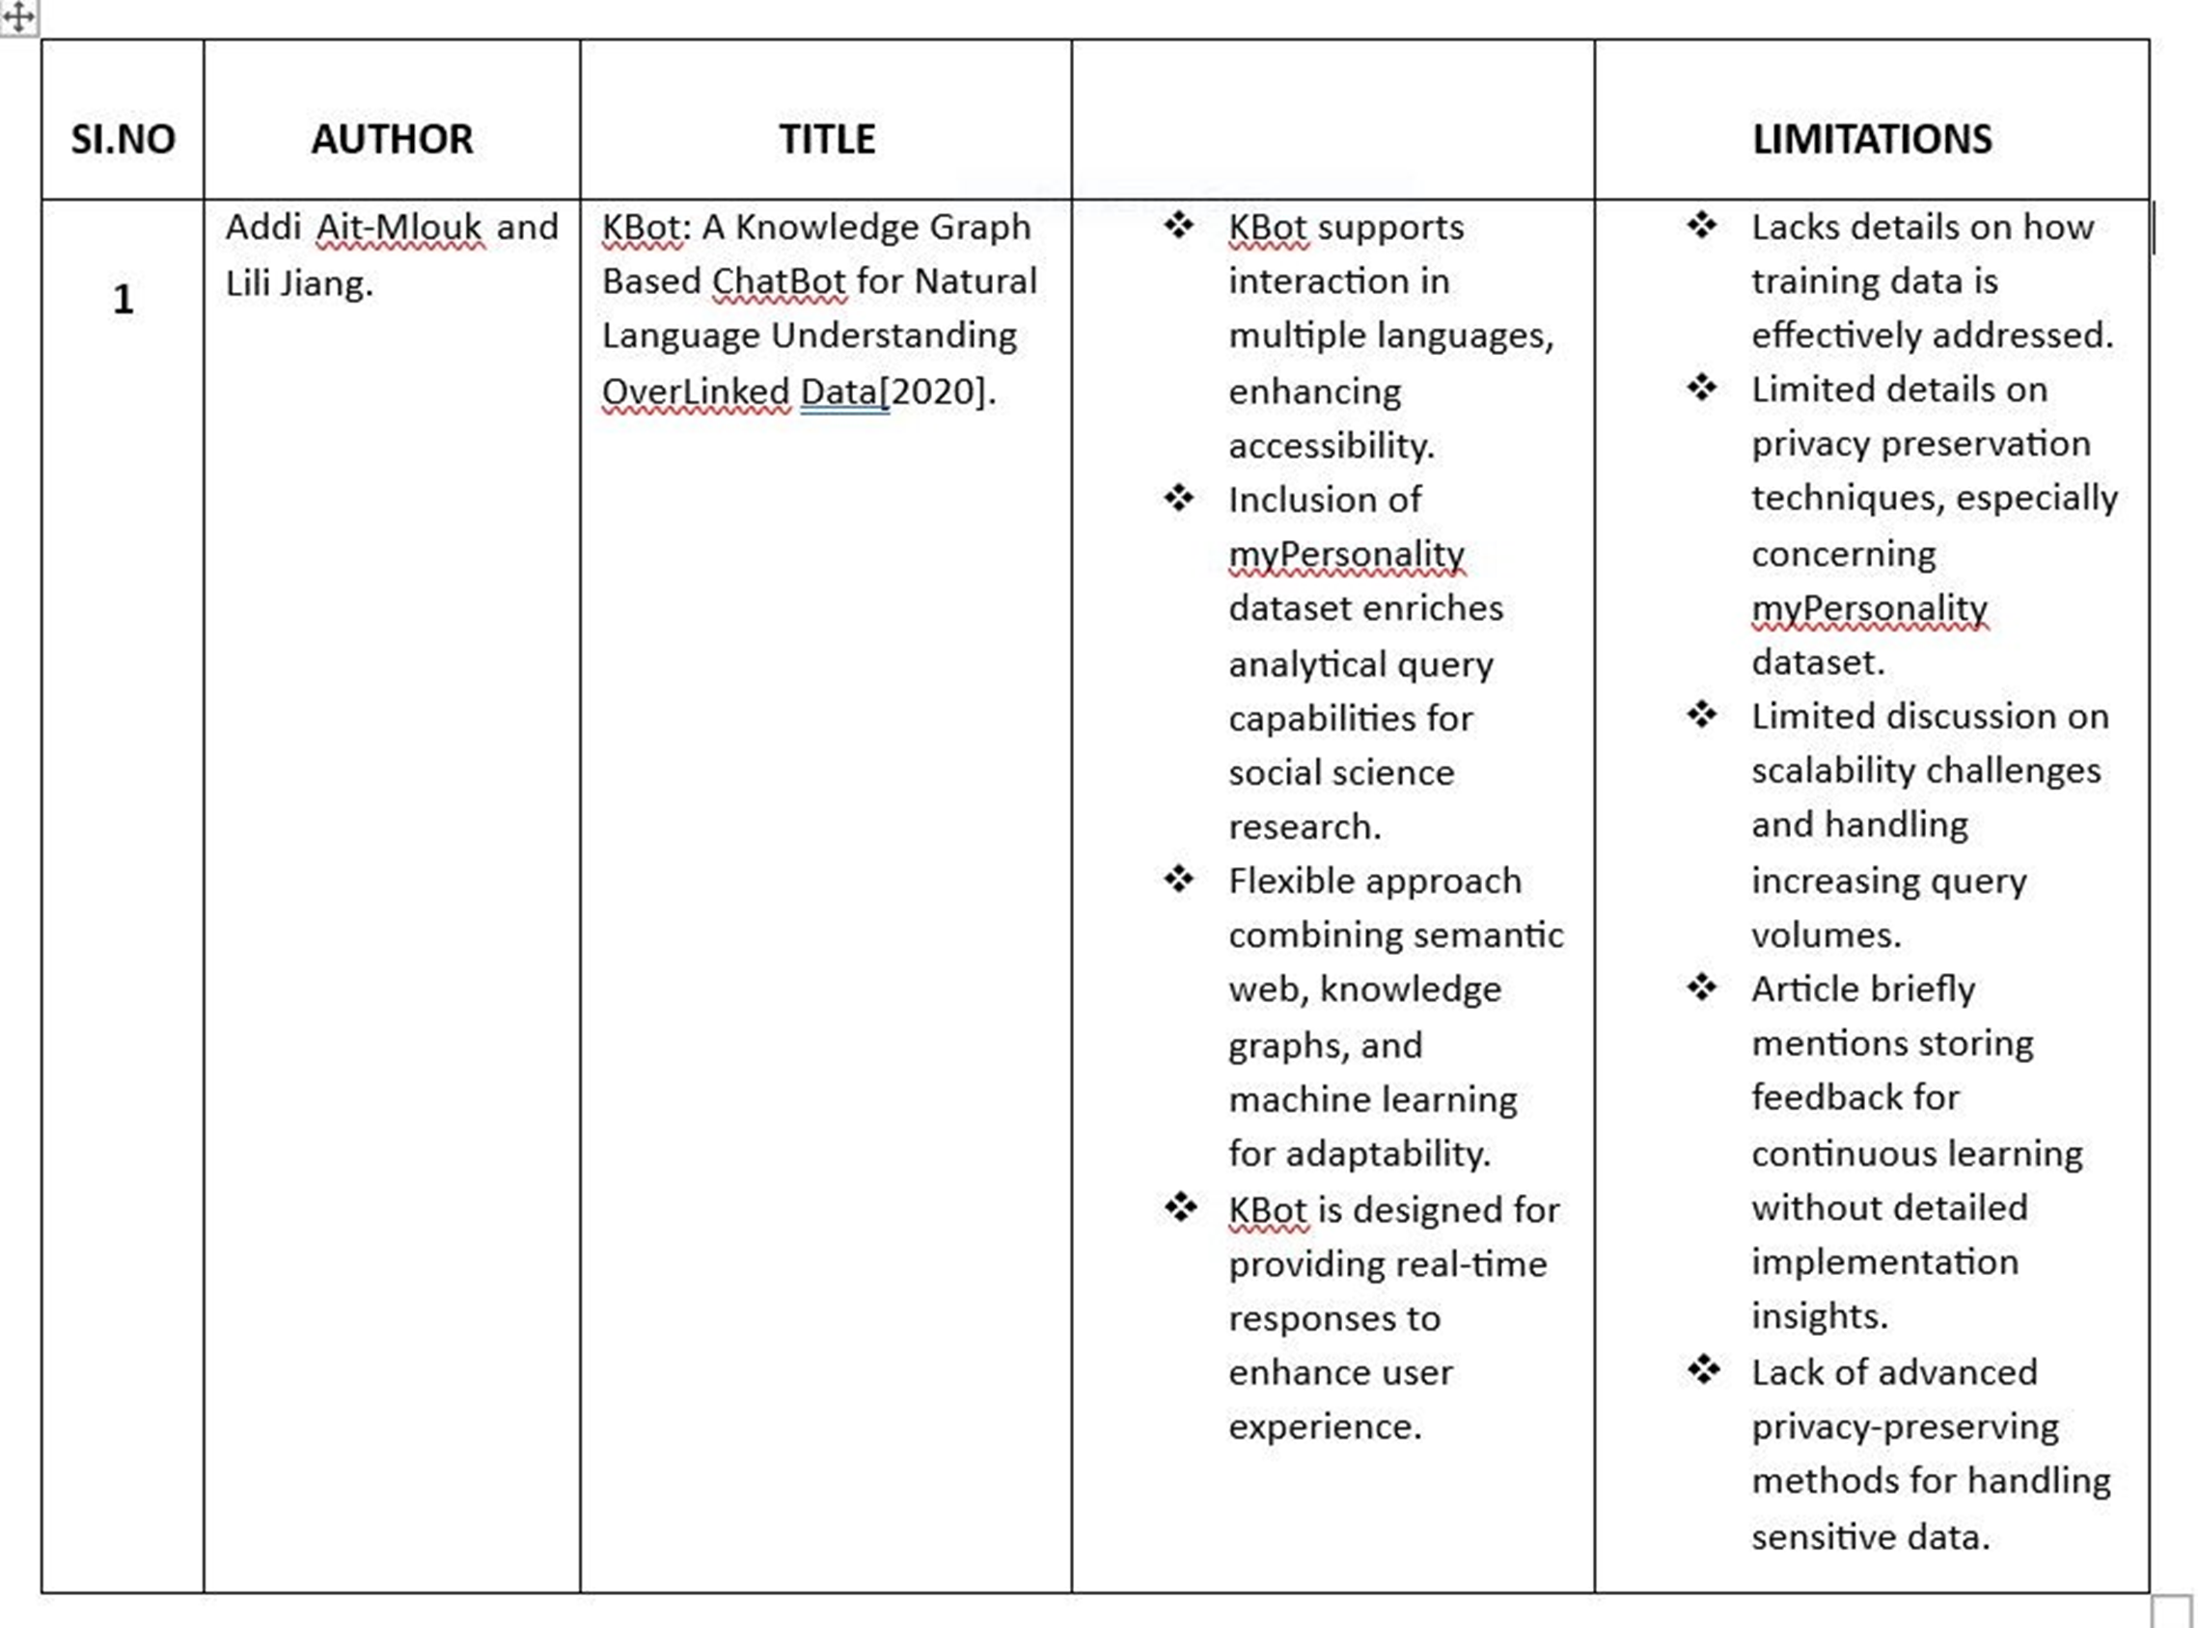

Slide 16
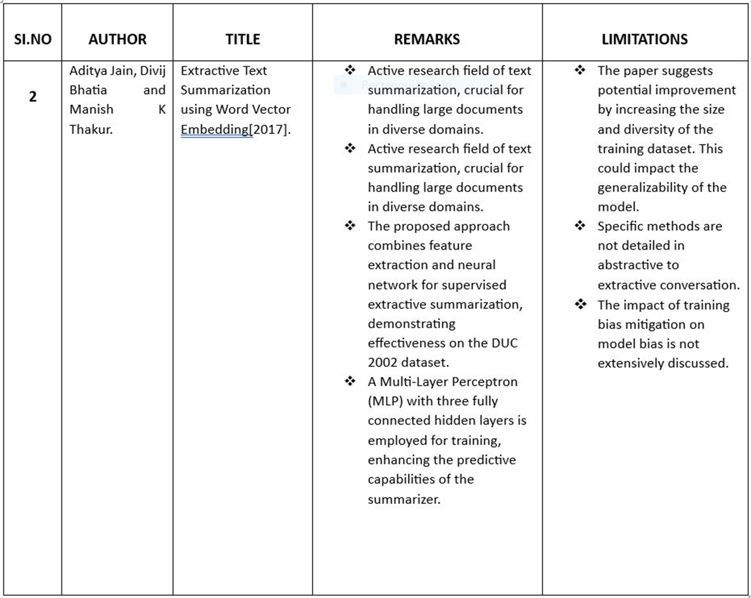

Slide 17
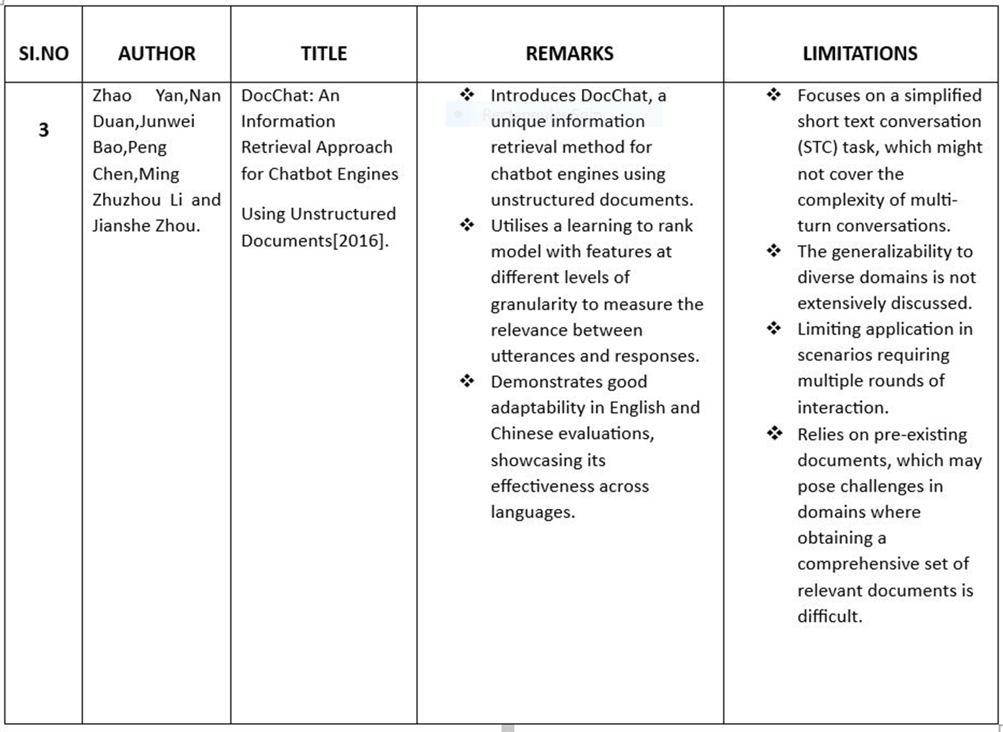

Slide 18
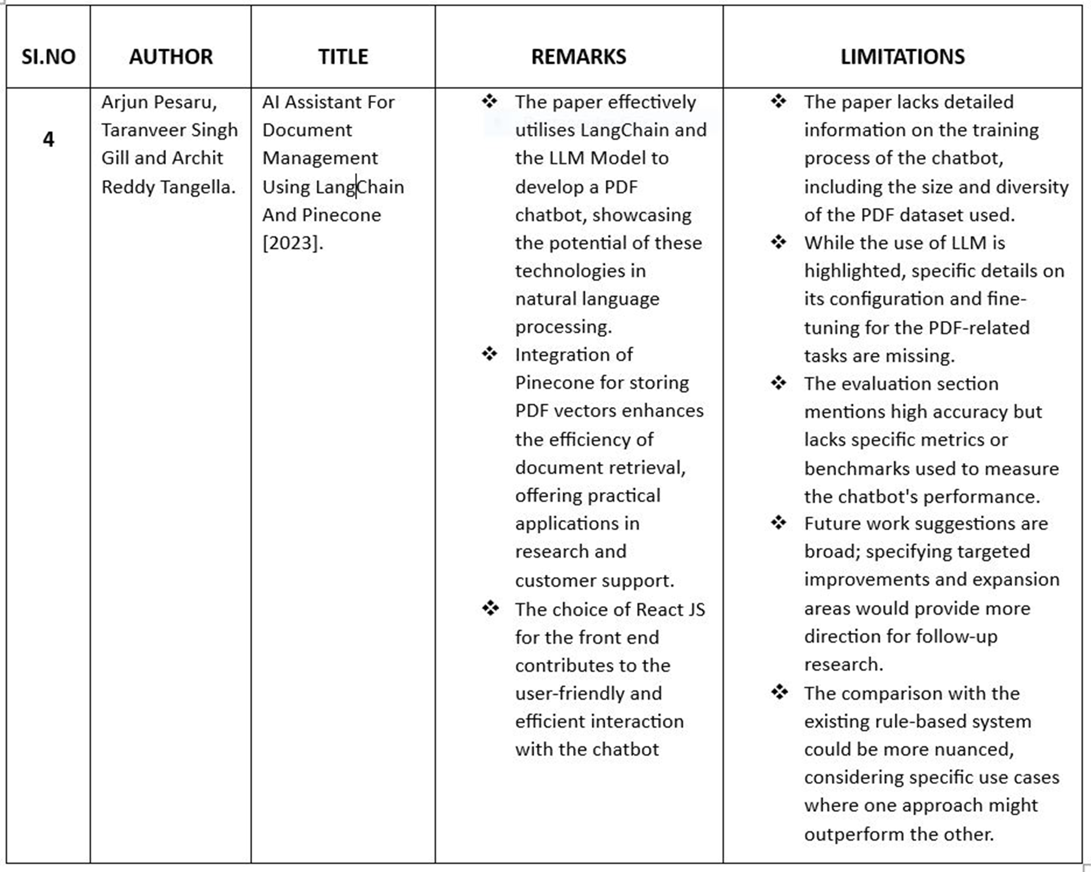

Slide 19
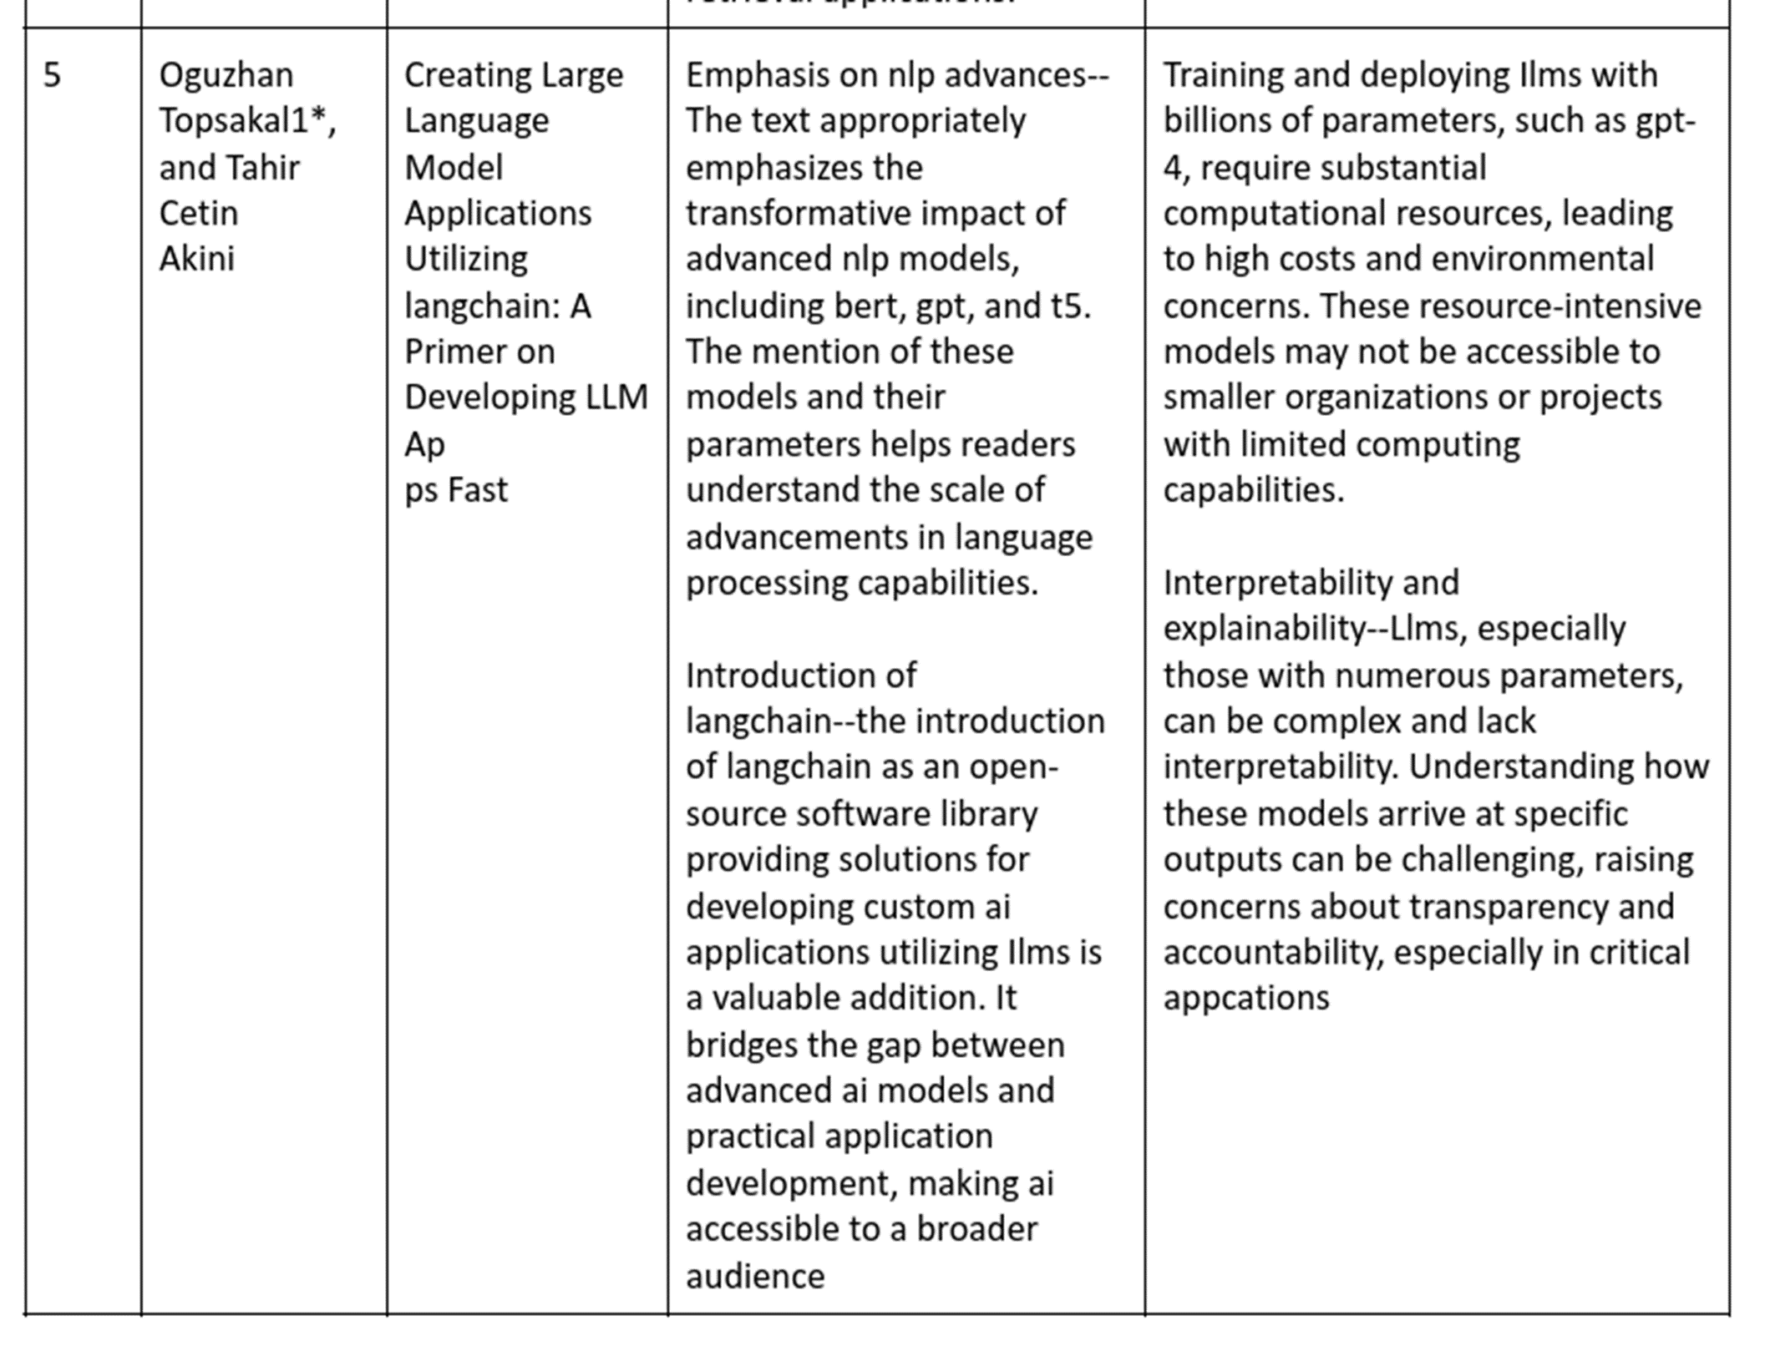

Slide 20
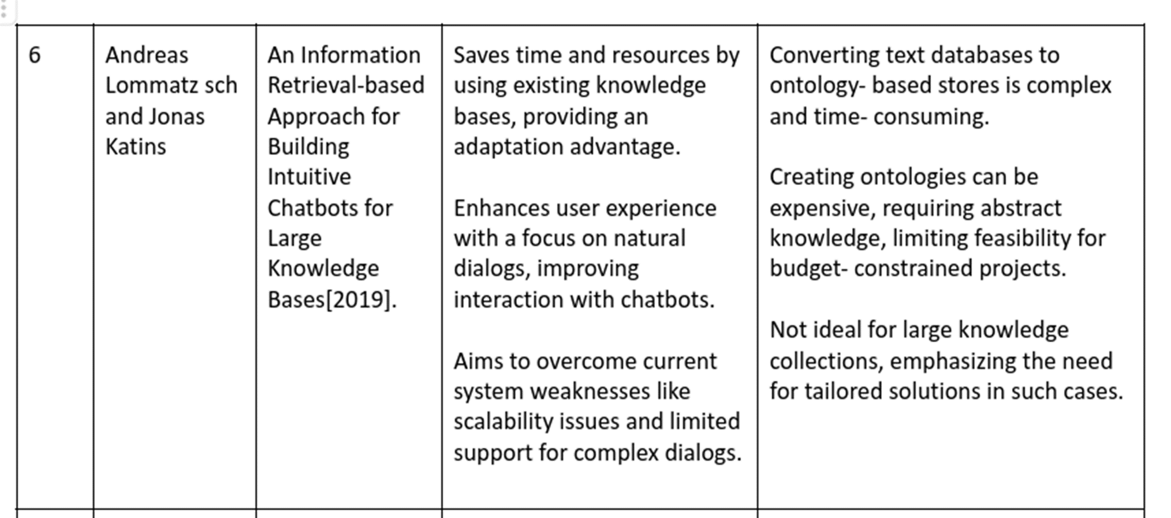

Slide 21
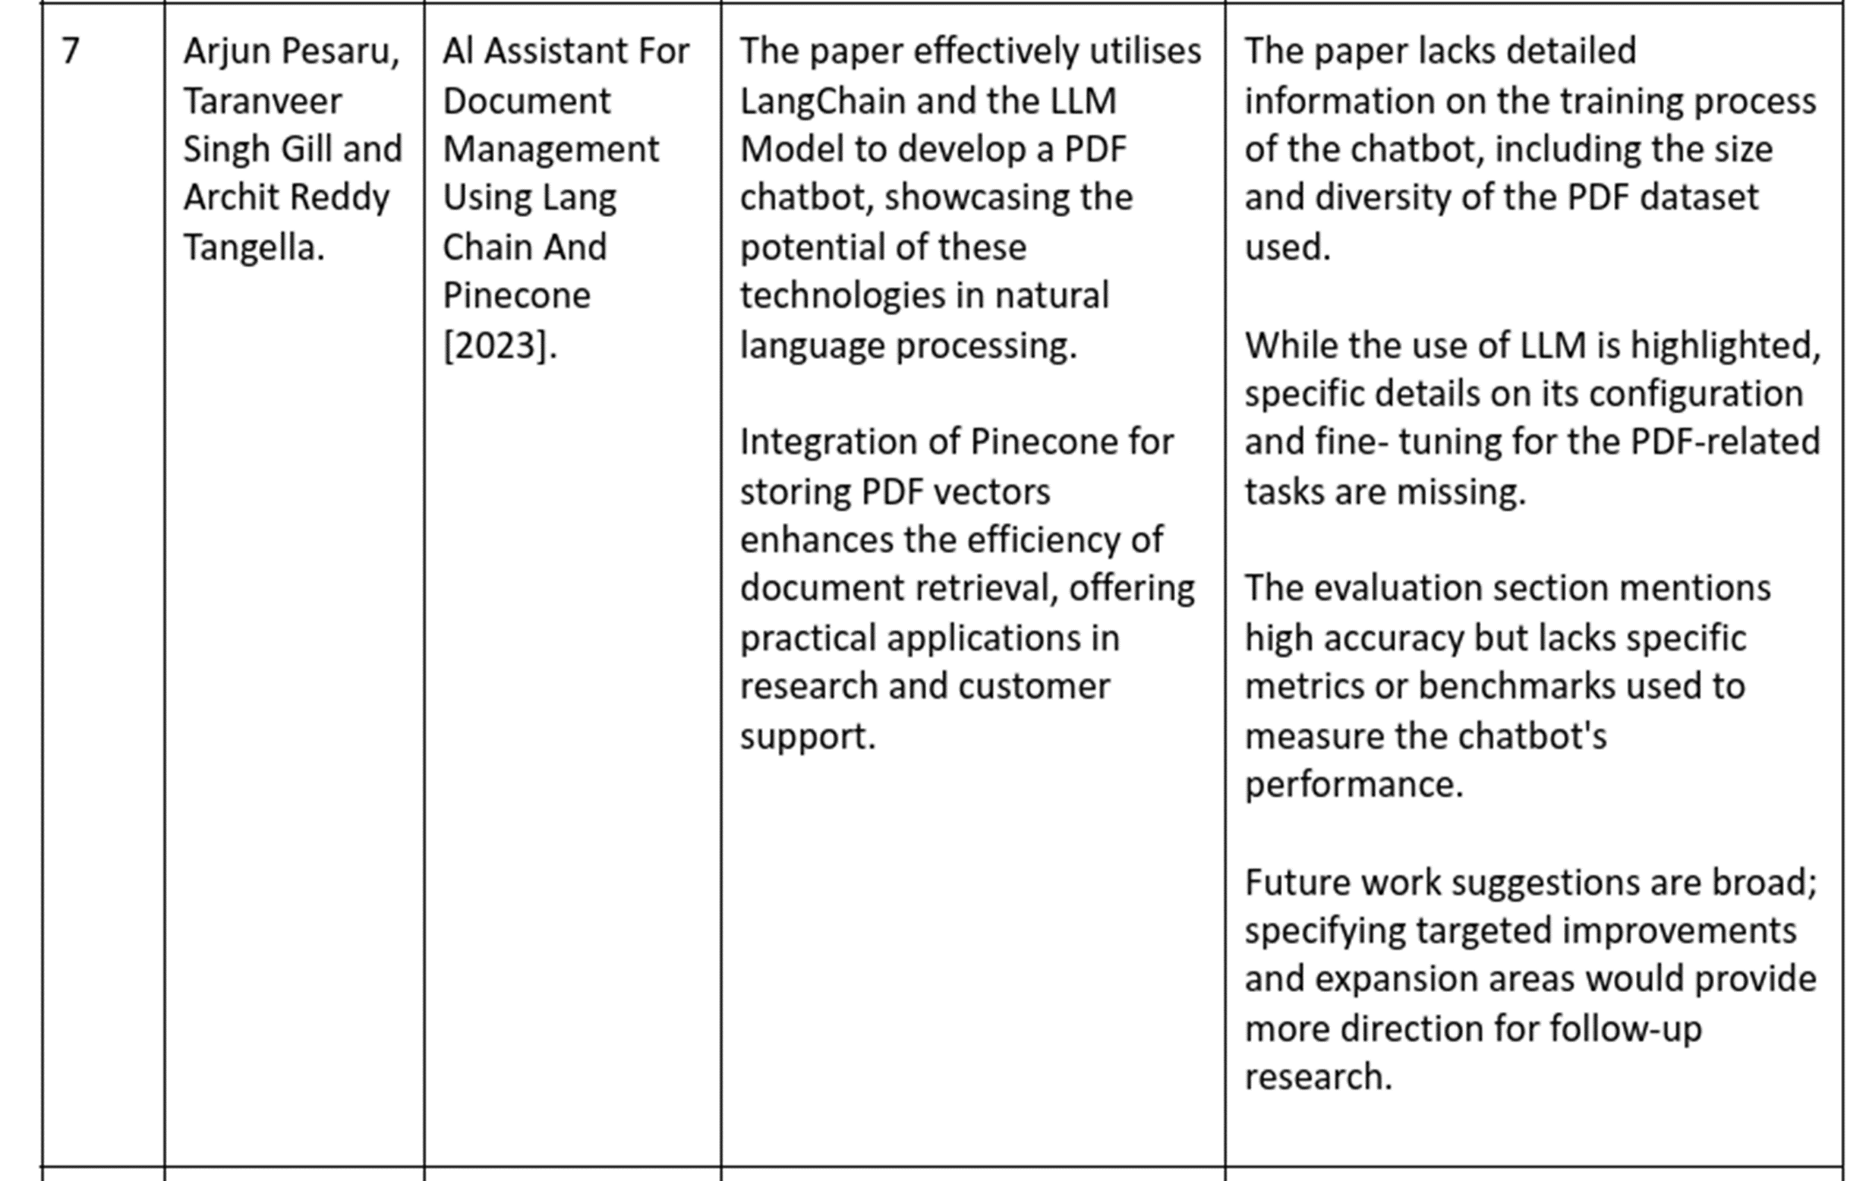

Slide 22
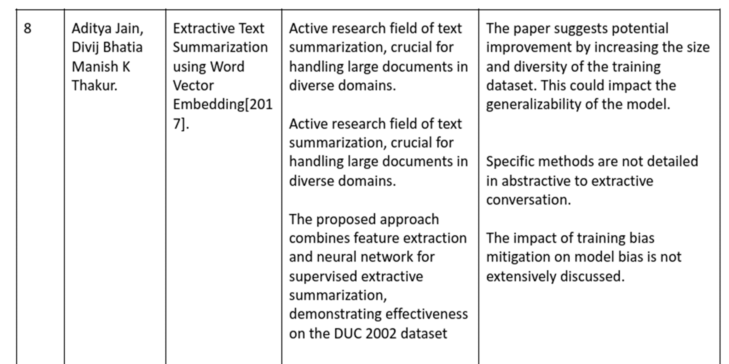

Slide 23
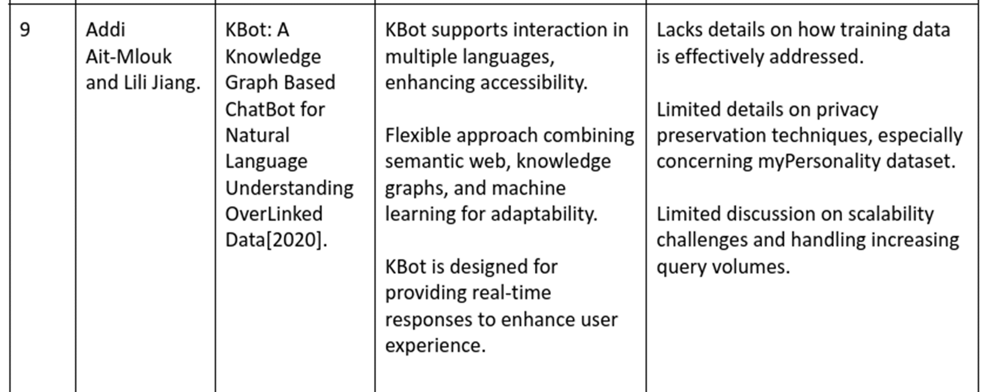

Slide 24
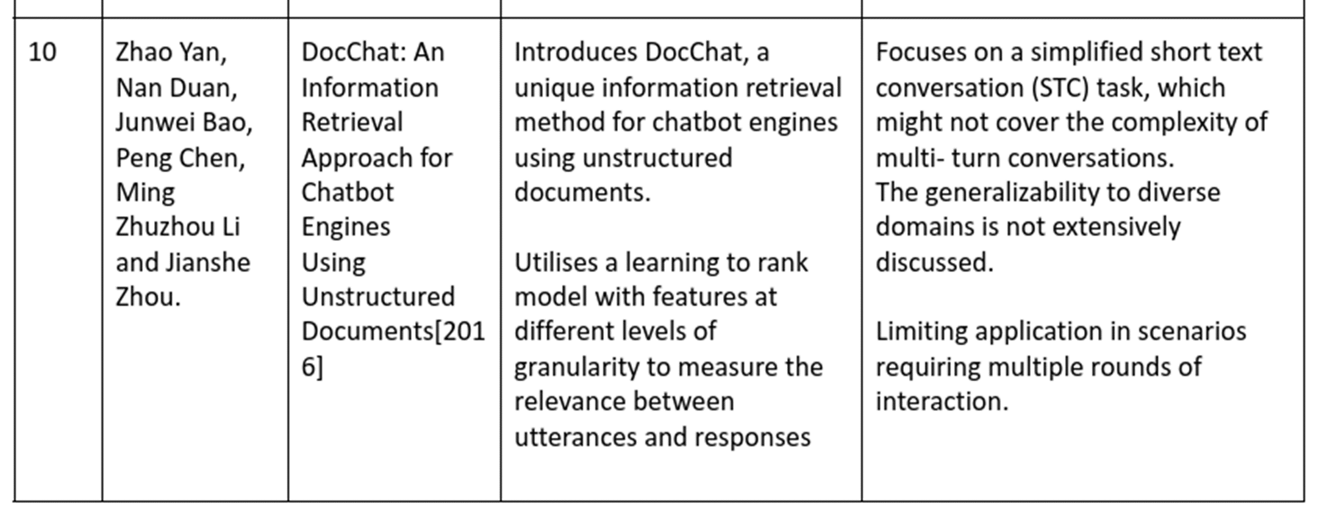

Slide 25
EXISTING WORK

Slide 26
EXISTING APPROCH
Manual Context Creation: Many solutions require users to manually provide context and structure to their notes and documents. This can be time-consuming, tedious, and prone to errors.
Limited Contextual Understanding: Existing chatbots often struggle to understand the full context of user queriesThis can lead to irrelevant or inaccurate responses.
.

Slide 27
LIMITATION
Inefficient: Manual context creation is a significant bottleneck, hindering user productivity and research efficiency.
Inaccurate: Limited contextual understanding can lead to irrelevant or inaccurate responses, frustrating users and hindering research progress.

Slide 28
OBJECTIVES
Document Question Answering Conversational Interaction: They utilize chatbot interfaces (using Streamlit) to facilitate a natural and engaging user experience, allowing users to ask follow-up questions and engage in a dialogue with the system. Retrieval Augmented Generation (RAG) Advanced Techniques (Fusion, Decomposition): RAG-Fusion (generating multiple search queries and fusing results) and Question Decomposition (breaking down complex questions into sub-questions for more accurate answers).

Slide 29
ADVANTAGES
Increased Efficiency: Automatic context creation saves users time and effort, improving research productivity.
Improved Accuracy: Deep contextual understanding leads to more relevant and informative responses, enhancing knowledge discovery.
Greater User Control and Customization: Open-source nature allows users to tailor the chatbot to their specific needs and preferences.

Slide 30
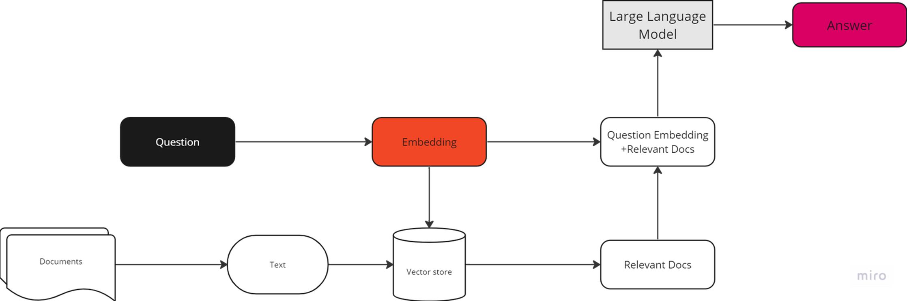
OVERALL ARCHITECTURE

Slide 31
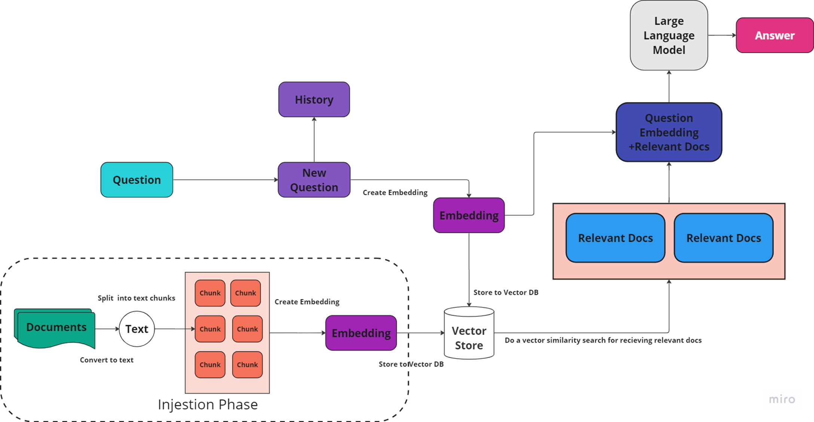
DETAILED ARCHITECTURE

Slide 32
METHODOLOGY
1]Document Loading and Processing
PDFs: Use PyPDFLoader to load & split intopages.
Websites: Use WebBaseLoader to extract texts
YouTube: Use YoutubeLoader to fetch transcripts
Images: use Google Gemini Pro Vision API to process.

Slide 33
METHODOLOGY
2]Document Splitting and Embedding
Spliting Use RecursiveCharacterTextSplitter to divide documents into manageable chunks
Embedding GoogleGenerativeAIEmbeddings and BAAI/bge-small-en
3]Vector store chroma (chunks)
Retrieval (Question embedding vector store
Similarity search Return top matching chunk

Slide 34

SAMPLE IMAGES

Slide 35

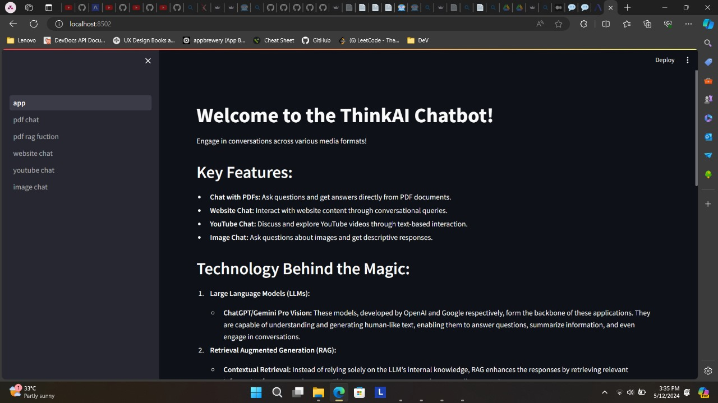
A PICTURE ALWAYS REINFORCES THE CONCEPT
Images reveal large amounts of data, so remember: use an image instead of a long text

Slide 36
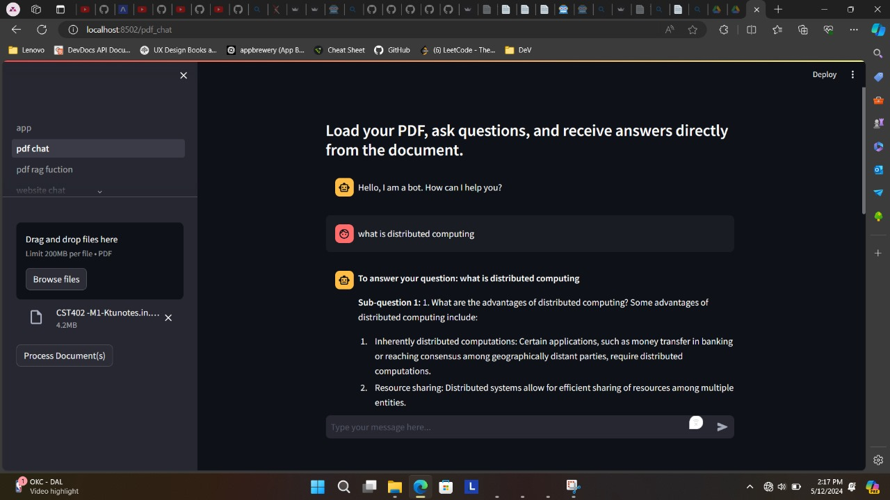
A PICTURE ALWAYS REINFORCES THE CONCEPT
Images reveal large amounts of data, so remember: use an image instead of a long text

Slide 37
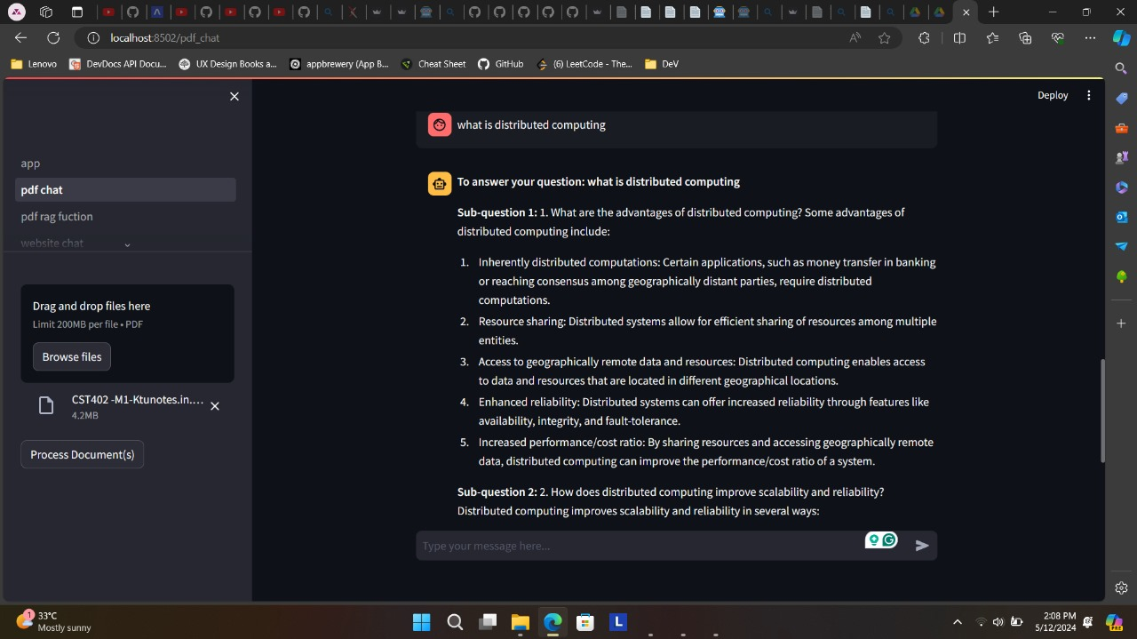
CASE STUDY
 | CHALLENGE | RESULTS | SOLUTION
PROJECT 1 | Mercury is the smallest planet | Venus has a beautiful name | Mars is actually a cold place
PROJECT 2 | Jupiter is the biggest planet | Saturn is the ringed one | Neptune is the farthest planet
PROJECT 3 | Earth is where we all live on | Pluto is a dwarf planet | The Moon is a satellite

Slide 38
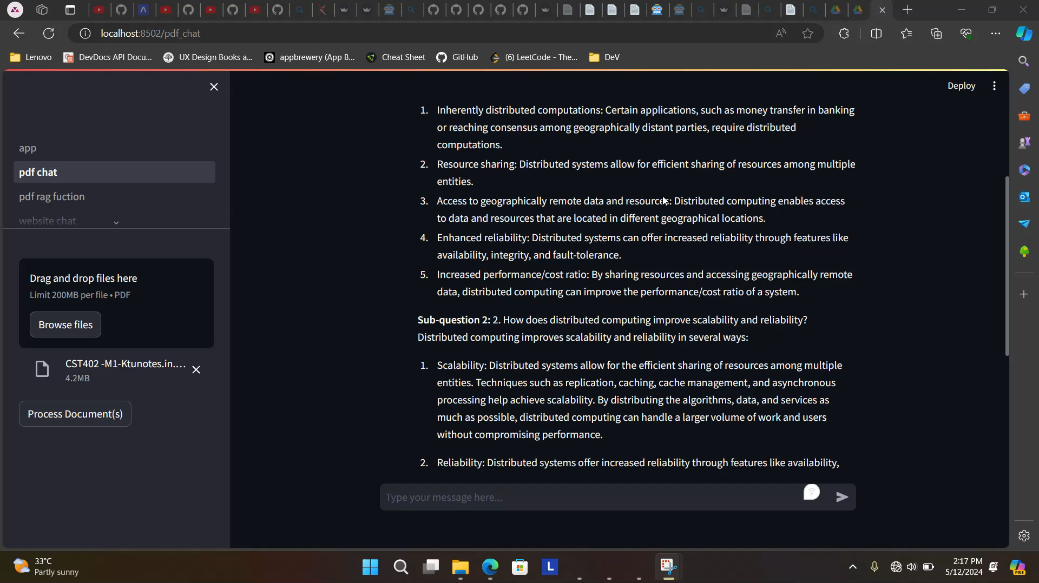
REVIEWS
HELENA JAMES
TIMMY JIMMY
Despite being red, Mars is actually a very cold place. It’s full of iron oxide dust
Mercury is the closest planet to the Sun and the smallest one in the Solar System

Slide 39
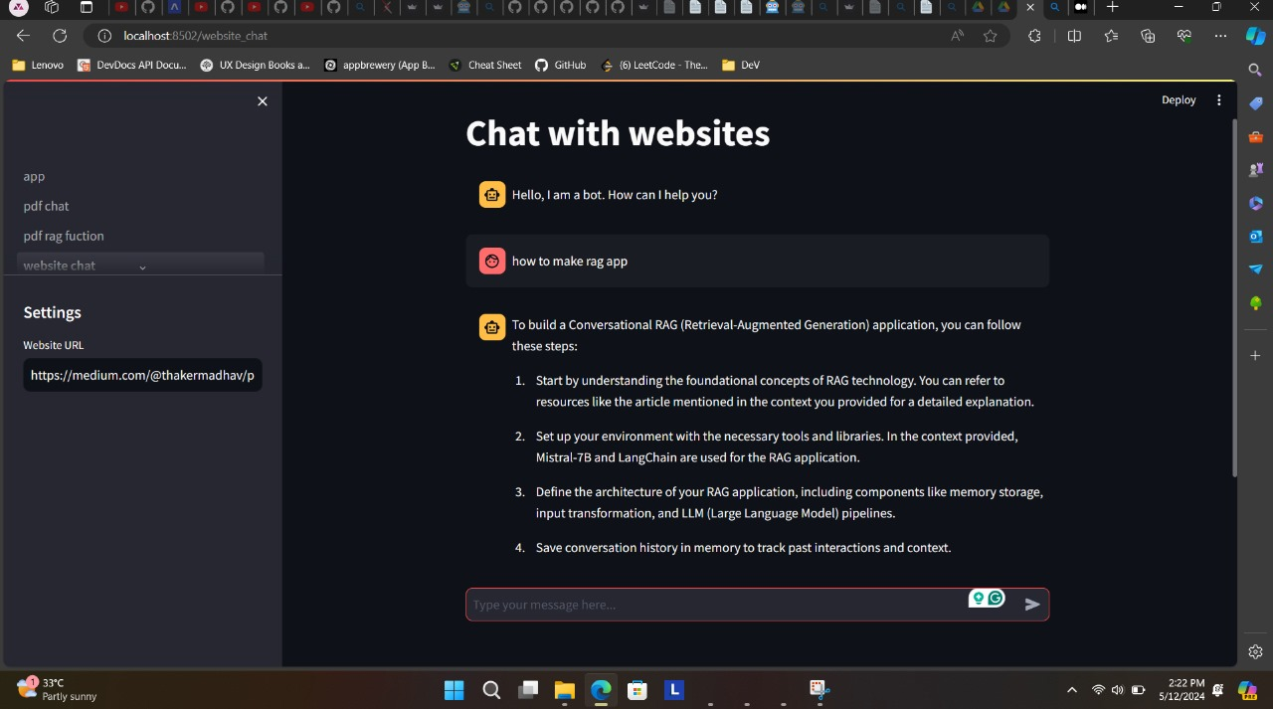
MARKET SIZE
60%
80%
25%
60%
Despite being red, Mars is actually cold
Jupiter is the biggest planet in the Solar System
Saturn is a gas giant and has several rings
Mercury is the smallest planet in the Solar System

Slide 40
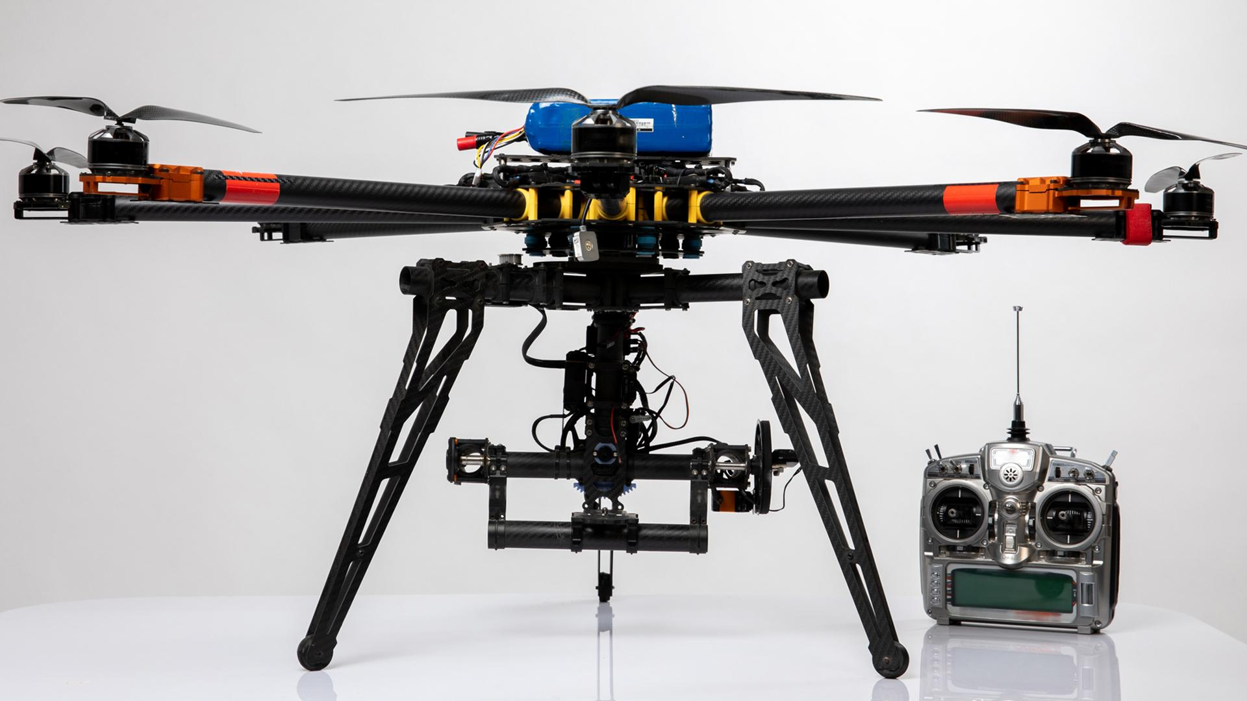
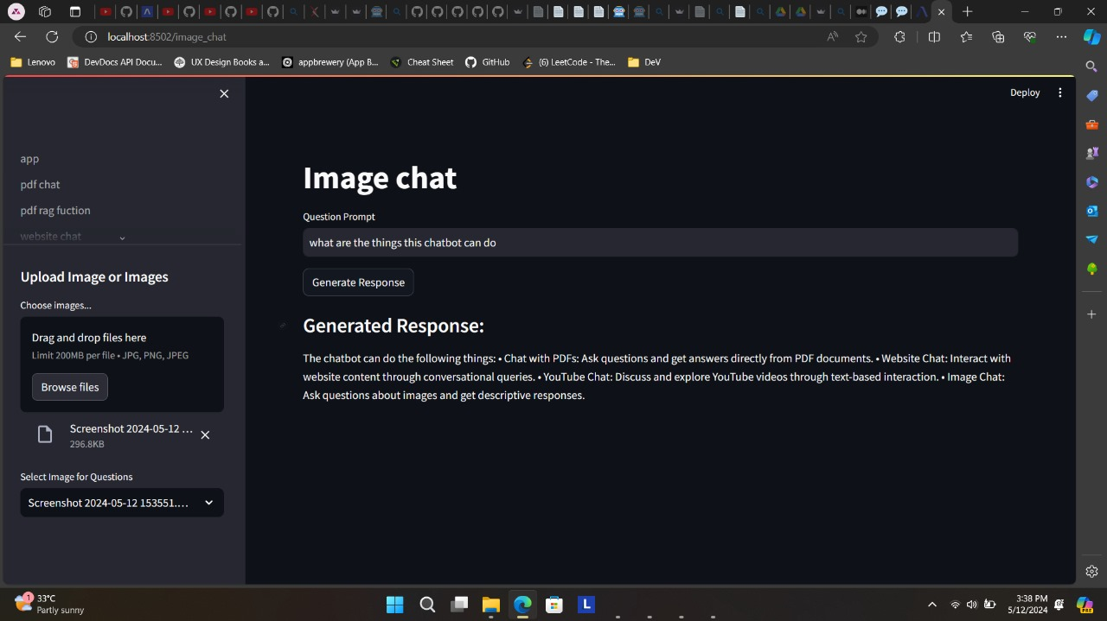
A PICTURE IS WORTH A THOUSAND WORDS

Slide 41
CONCLUSION
Make information accessible: Easily get answers from any document (PDFs, websites, videos, images).
Improve how we interact with data: Chatbots provide a natural and engaging way to ask questions and explore information.
Show the power of AI: AI can understand and generate human-like responses from different sources.
Lead to exciting new possibilities: Pave the way for smarter search engines and information tools

Slide 42
REFERENCE
[1] Aditya Jain, Divij Bhatia, Manish K Thakur [2017], Extractive Text Summarization using Word Vector Embedding , https://ieeexplore.ieee.org/document/8320258
[2] Addi Ait-mlouk AND Lili Jiang [2020], KBot: A Knowledge Graph Based ChatBot forNatural Language Understanding Over Linked Data , https://ieeexplore.ieee.org
[3] Zhao Yan, Nan Duan, Junwei Bao, Peng Chen, Ming Zhou, Zhou Li, Jianshe Zhou [2016] , DocChat: An Information Retrieval Approach for Chatbot EnginesUsing Unstructured Documents, https://aclanthology.org/P16-1049.pdf
[4] Arjun Pesaru, Taranveer Singh Gill, Archit Reddy Tangella [2023] , AI ASSISTANT FOR DOCUMENT MANAGEMENT USING LANG CHAIN AND PINECONE , https://www.irjmets.com
[5] Haritha Akkineni, P. V. S. Lakshmi, and Lasya Sarada [2022] , Design and Developmentof Retrieval-Based Chatbot UsingSentence Similarity, https://link.springer.com
6] Oguzhan Topsakal1, and Tahir Cetin Akinci [2023] , Creating Large Language Model Applications Utilizing LangChain: A Primer on Developing LLM Apps Fast , https://as-proceeding.com

Slide 43
REFERENCE
[7] Andreas Lommatzsch and Jonas Katins [2019] , An Information Retrieval-based Approach for
Building Intuitive Chatbots for Large
Knowledge Bases , https://ceur-ws.org/Vol-2454/paper_60.pdf
[8] Norbert Braunschweiler and Rama Doddipatla and Simon Keizer and
Svetlana Stoyanchev[2023], Evaluating Large Language Models for Document-grounded Response
Generation in Information-Seeking Dialogues , https://arxiv.org
[9] Arjun Pesaru, Taranveer Singh Gill, Archit Reddy Tangella [2023] , AI ASSISTANT FOR DOCUMENT MANAGEMENT USING LANG
CHAIN AND PINECONE , https://www.irjmets.com
[10] Pinky Sitikhu,Kritish Pahi,Pujan Thapa,Subarna Shakya[2019] , A Comparison of Semantic Similarity Methods for
Maximum Human Interpretability, https://arxiv.org/abs

Slide 44


THANKS…

